Slide 1
Housing Price Prediction Project
Submitted By:
SYED MUGERA BILAL
syedbilalarmaan@gmail.com

Slide 2
Contents
About the project
Business Goal
Data source & their formats
Hardware, Software and Tools
Data Analysis
Data Cleaning
Exploratory Data Analysis (EDA)
Checking for outliers
Checking for skewness
Standardization / Scaling
Using PCA Technique
Splitting the data
Building Machine Learning Algorithms
Evaluation of ML Models
Result of ML Models
Key Metrics for success in solving problem under consideration
Conclusion

Slide 3
About the project
Business Problem
Houses are one of the necessary need of each and every person around the globe and therefore housing and real estate market is one of the markets which is one of the major contributors in the world’s economy. It is a very large market and there are various companies working in the domain.
Data science comes as a very important tool to solve problems in the domain to help the companies increase their overall revenue, profits, improving their marketing strategies and focusing on changing trends in house sales and purchases. Predictive modelling, Market mix modelling, recommendation systems are some of the machine learning techniques used for achieving the business goals for housing companies. Our problem is related to one such housing company.

Slide 4
A US-based housing company named Surprise Housing has decided to enter the Australian market. The company uses data analytics to purchase houses at a price below their actual values and flip them at a higher price. For the same purpose, the company has collected a data set from the sale of houses in Australia. The data is provided in the CSV file below.
The company is looking at prospective properties to buy houses to enter the market. You are required to build a model using Machine Learning in order to predict the actual value of the prospective properties and decide whether to invest
in them or not. For this company wants to know:
• Which variables are important to predict the price of variable?
• How do these variables describe the price of the house?

Slide 5
Business Goal
We are required to model the price of houses with the available independent variables. This model will then be used by the management to understand how exactly the prices vary with the variables. They can accordingly manipulate the strategy of the firm and concentrate on areas that will yield high returns. Further, the model will be a good way for the management to understand the pricing dynamics of a new market.
Data source and their format
The data is given by US-based housing company named Surprise Housing
and they gave it to us in a CSV file, with data description file in pdf and txt format. They also had provided the problem statement by explaining what they need from us and also the required criteria to be satisfied.

Slide 6
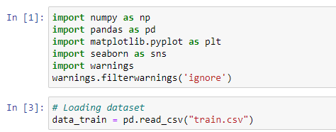
Hardware, Software and Tools
For doing this project, we require laptop with high configuration and specification with a stable Internet connection.
Microsoft office, Anaconda distribution as software.
Python 3.x as programming language.
Jupyter Notebook as Editor which is in Anaconda navigator.
Some tools or libraries required like Numpy – used to numerical calculations. Pandas – used to data manipulation. Matplotlib and Seaborn – used to data visualization.

Slide 7

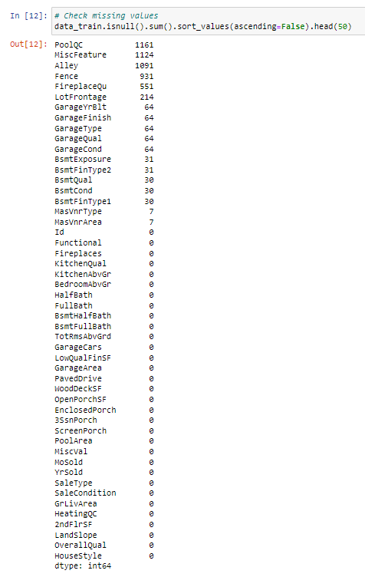
Data Analysis
The train dataset has 1168 rows and 81 columns.
There are 1161 missing values in the column PoolQC, 1124 in MiscFeature, 1091 in Alley, 931 in Fence, 551 in FireplaceQu, 214 in LotFrontage, 64 each in GarageYrBlt, GarageFinish, GarageTyp, GarageQual, GarageCond, 31 in BsmtExposure and BsmtFinType2, 30 in BsmtQual, BsmtCond and BsmtFinType1, 7 in MasVnrType, MasVnrArea...present in dataset. We need to handle these null values.

Slide 8
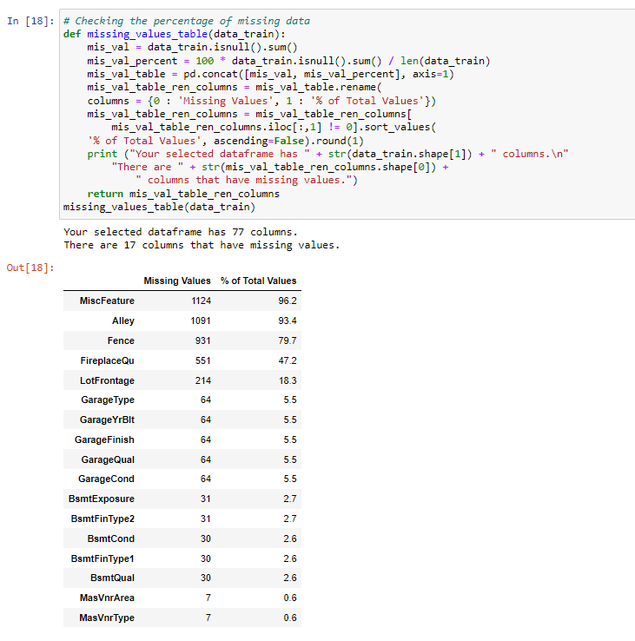
Checking percentage of missing data

Slide 9
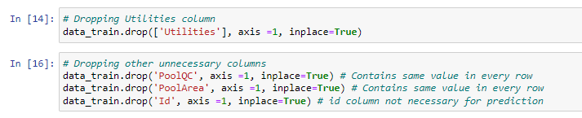
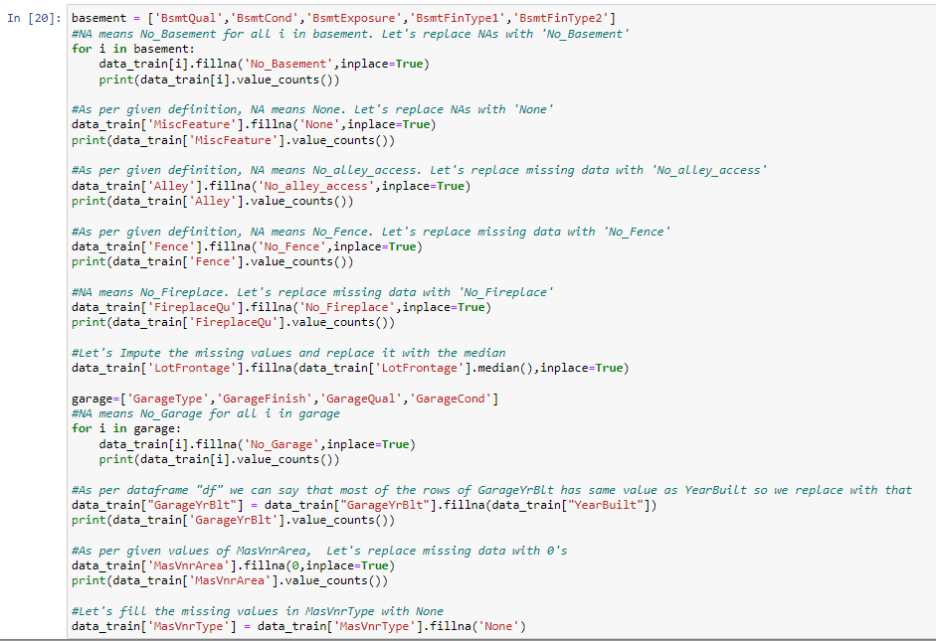
Data Cleaning
Removing unnecessary features.
Imputing the missing values.

Slide 10
Exploratory Data Analysis (EDA)
Observations from univariate analysis:
By looking at countplot of MSZoning ,which Identifies the general zoning classification of the sale,we find that 79 % of houses were sold in Low density resedential Areas.
For street ,which states:Type of road access to property,we observe that almost 100% of house which were sold had access to paved roads so we can consider that no houses were purchased which had gravel road access.
For Alley,93% of the purchased house do not have access to alley.Only 4% have gravel & 3% have paved alley.
LotShape : 63% of the sold property was of Regular shape followed by slightly irregular type (33%).It means Australian gives priority to regular shaped houses.

Slide 11
LandContour :90% of sold houses were neary flat level.
LotConfig : 72% of purchased houses had Inside lot of the property.
LandSlope :Around 95% of the sold property had gentle slope.
Neighborhood: Physical locations within Ames city limits-:highest 16% of purhcased houses has neighbourhood of NWAmes(Northwest Ames) followed by CollgCr(College Creek) and least houses were purchased in neighbour hood of Bluestem.
Condition1: Proximity to various conditions-:86% of purchased houses had normal proximity to various conditions1 and least 0.00 had RRne,RRNn proximity.
Condition2: Proximity to various conditions (if more than one is present)-:99% of purchased houses had normal proximity to various conditions2.

Slide 12
BldgType: Type of dwelling-:84% purchased houses were single family detached,followed by 8% 2FmCon(Two-family Conversion).
HouseStyle: Style of dwelling-:49% houses had 1story followed by 2story style (31%)
RoofStyle: Type of roof-:78% of houses have Gable roof style and 19% have Hip roof style.
RoofMatl: Roof material-:98% houses have CompShg(Standard (Composite) Shingle) roof material.
Exterior1st: Exterior covering on house-:34% houses have Vinylsiding covering on exteriors 15% have hard board and metal siding.
Exterior2nd: Exterior covering on house (if more than one material)-:33% houses have VinylSd(Vinyl Siding) 15% have hard board and metal siding.

Slide 13
MasVnrType: Masonry veneer type-:60% of houses have no masonry veneer type followed by BrkFace(Brick Face) (30%)
ExterQual: Evaluates the quality of the material on the exterior-:61% of the sold hoUse have TA(Average/Typical) quality material on exterior followed by Gd(Good) 34%
ExterCond: Evaluates the present condition of the material on the exterior-:88% houses are currently in TA(average) condition of exterior material.
Foundation: Type of foundation-:44% houses have foundation CBlock(Cinder Block) & 44% have PConc(Poured Contrete)
BsmtQual: Evaluates the height of the basement-:44% of houses have TA(typical) (80-89 inches) basement height followed by Gd(Good) (90-99 inches)
BsmtCond: Evaluates the general condition of the basement-:89% of houses have TA(Typical - slight dampness allowed) basment

Slide 14
BsmtExposure: Refers to walkout or garden level walls-:64% of houses have No(No Exposure) followed by Av(Average Exposure ) 15%
BsmtFinType1: Rating of basement finished area-:(30%) have Unf(Unfinshed) basement area and 28% comes under GLQ(good living quarters)
Heating: Type of heating-:98% houses have GasA(Gas forced warm air furnace) heating type.
HeatingQC: Heating quality and condition-:30% houses have average quality heating.
CentralAir: Central air conditioning-:93% houses are central air.
Electrical: Electrical system-:92% houses have SbrKr(Standard Circuit Breakers & Romex) type of electrical systems.
KitchenQual: Kitchen quality-:49% houses have average (TA) kitchen quality.

Slide 15
Functional: Home functionality (Assume typical unless deductions are warranted)-:92% houses have typical (TA) home functionality.
FireplaceQu: Fireplace quality-:47% of the houses donot have fireplace,25% houses have Gd(Good - Masonry Fireplace in main level) FireplaceQuality.
GarageType: Garage location-:57% houses have Attached garage type,while 29% have Detchd(Detached from home).
GarageFinish: Interior finish of the garage:42% of houses have unfinished garage while 29% have RFn(Rough Finished).
GarageQual: Garage quality-:90% of houses have average garage quality.
GarageCond: Garage condition-:91% of houses have TA( average garage condition).
PavedDrive: Paved driveway-:92% of houses have Y( paved drive) way.

Slide 16
Fence: Fence quality-:89% houses have NA(no fence).
MiscFeature: Miscellaneous feature-:96% houses have no miscellaneous features.
SaleType: Type of sale-:85% houses have sale type WD(warranty deed -conventional).
SaleCondition:81% of houses are in normal sale condition

Slide 17
Observations from bivariate analysis:
MSZoning:The avg sale price of the house is maximum in FV(Floating Village Residential) foloowed by RL(Residential Low Density) zone.
Street:The property that have access to paved road have much higher average sale price as compared to that with gravel street.
Alley:houses that do not have access to alley have higher sale price as compared to those with paved or gravel alley.
LotShape:sale price is not much affected by lotshape,however IR2(Moderately Irregular) have a bit higher price compared to other while Reg(Regular) have lowest avg sale price.
LandContour:Flatness of the property-:HLS(Hillside - Significant slope from side to side) have maximum average sale price & Bnk(Banked - Quick and significant rise from street grade to building) have miimum average sale price.

Slide 18
LandSlope: It doesn't affect the average sale price of house.
Neighborhood:The houses that has a neighbourhood of NoRidge(Northridge) has the maximum sale price followed by that with a neighbourhood of NridgHt(Northridge Heights)
Condition1:house that is RRAn(Adjacent to North-South Railroad) has hightest avg sale price followed by PosA(Adjacent to postive off-site feature) while houses that is Artery(Adjacent to arterial street) has a minimum average sale price.
BldgType: Type of dwelling-:TwnhsE(Townhouse End Unit) & 1Fam(Single-family Detached) type house have hightset selling price.
HouseStyle: Style of dwelling-:The average sale price of 2.5Fin(Two and one-half story) is maximum followed by 2Story(Two story). 1.5Unf(One and one-half story: 2nd level unfinished) have lowest avg selling price.

Slide 19
RoofMatl: Roof material-:House with roof material WdShngl(Wood Shingles) have a very high average selling price,followed by that with roof of WdShake(Wood Shakes),while house with roof material Roll(Roll) have lowest sale price.
Exterior1st: Exterior covering on house-:House with exterior covering of ImStucc(Imitation Stucco) have maximum selling price while that with exterior coverng of BrkComm(Brick Common) have minimum average selling price.
ExterQual: Evaluates the quality of the material on the exterior-:Houses with exterior material of excellent quality have highest saelling price followed by that of gd(good) quality.
KitchenQual: Kitchen quality-:Houses with Ex(Excellent) kitchen quality have higher sale price while that with Fa(Fair) kitchen quality of lower selling price

Slide 20
Observations from multivariate analysis:
Maximum standard deviation of 8957.44 is observed in LotArea column.
Maximum SalePrice of a house observed is 755000 and minimum is 34900.
In the columns MSSubclass, LotArea, MasVnrArea, BsmtFinSF1, BsmtFinSF2, BsmtUnfsF, TotalBsmtSF, 1stFlrSF, 2ndFlrSF, LowQualFinSF, GrLivArea, BsmtFullBath, HalfBath, TotRmsAbvGrd, WoodDeckSF, OpenPorchSF, EnclosedPorch, 3SsnPorch, ScreenPorch, Miscval, salePrice mean is considerably greater than median so the columns are positively skewed.
In the columns FullBath, BedroomAbvGr, Fireplaces, Garagecars, GarageArea, YrSold Median is greater than mean so the columns are negatively skewed.

Slide 21
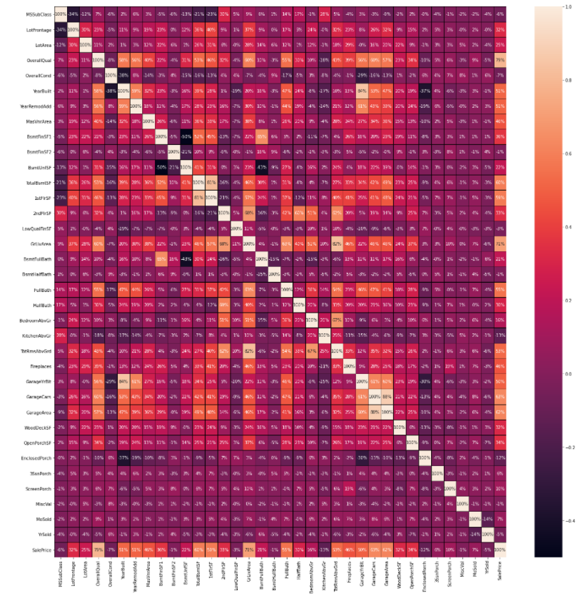
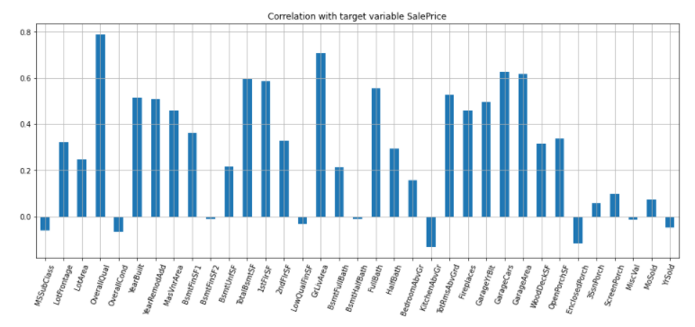
Heatmap

Slide 22
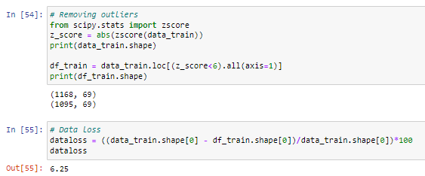
Checking for outliers
Outliers are the data points that differ significantly from other observations. Any data points greater than +3 and -3 standard deviations are called as outliers.
Z-score is the automated method used for handling outliers and it’s important to remove outliers as it impacts on the Accuracy of the Model.
During the outlier’s analysis, we found that we are losing nearly 6.25% of data and it’s not a big loss.

Slide 23
Checking for skewness
Skewed data are not normally distributed; either they are positive skewed or negative skewed. If the data is skewed, it impacts on the accuracy of the model. So, it’s very important to remove the skewness for right and left skewed data by using transform methods like square root transformation.
For visualization, we use distplot to check the distribution of data points and the shape of the curve. Any value greater than 0.55 or less than -0.55 is considered to be skewed data.
In our case, most of the data are skewed and hence we have to remove the skewness during Scaling because if we remove the skewness by square root transformation method it will induce nan values. Sometimes while using root transforms, it can cause to form nan values. It is better to remove those values before scaling because it will show ValueError while running the code.

Slide 24
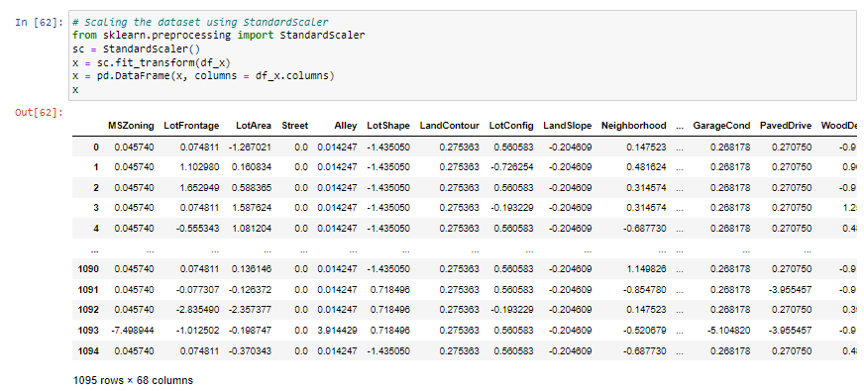
Standardization / Scaling
Standardization of data is done by using Standard Scaler.
Standard scaler is used to bring the data points to standard Normal Distribution having mean = 0 and SD +- 1 to enhance accuracy of the model. In our case, its most important due to presence of high skewed data and Outliers.

Slide 25
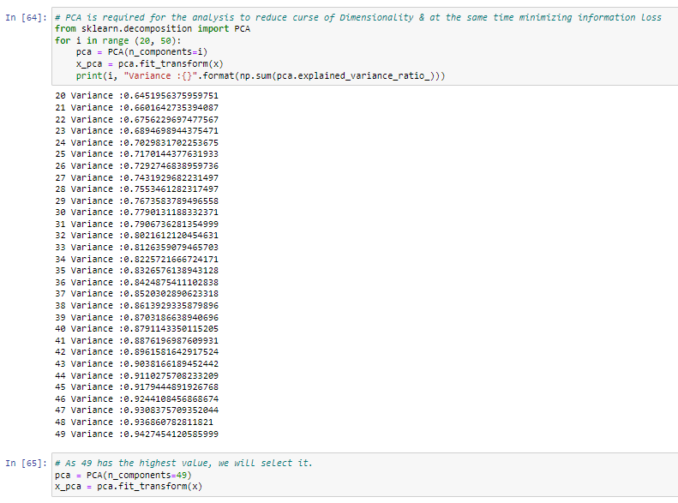
Using PCA Technique
An important machine learning method for dimensionality reduction is called Principal Component Analysis. It is a method that uses simple matrix operations from linear algebra and statistics to calculate a projection of the original data into the same number or fewer dimensions.

Slide 26
Splitting the data
We split our dataset into two parts training and testing, with 80% data of training and 20% of testing. We use train test split method.
80% of the observation as training set. x_train
The associated target for each observation in x_train , y_train
20% of the observation as test. x_test
The target associated with the test set. y_test
We found best score on random_state = 85

Slide 27
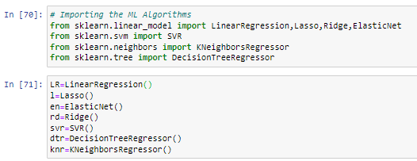
Building Machine Learning Algorithms
The following classifier algorithms we used are:
Linear Regression, Lasso, Ridge, ElasticNet
Decision Tree Regressor
KNeighbors Regressor
Support Vector Machine
Random Forest Regressor, AdaBoost Regressor, Gradient Boosting Regressor

Slide 28
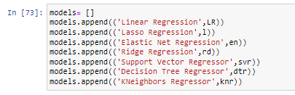
Evaluation of ML Models
As you can see , I had called the algorithms, then I called the empty list with the name models [ ], and calling all the model one by one and storing the result in that.
We can observe that I imported the metrics to find the r2_score, mean_absolute_error (MAE) ,mean_squared_error (MSE), root_mean_squared_error (RMSE) in order to interpret the model’s output. Then I also selected the model to find the cross_validation_score value.

Slide 29
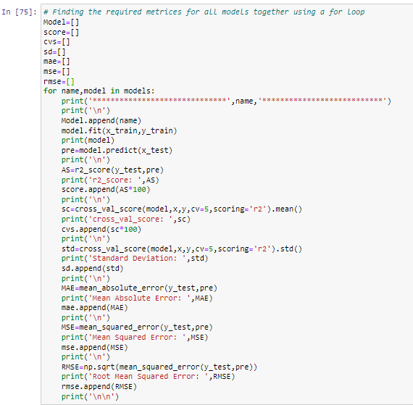
As you can observe, I made a for loop and called all the algorithms one by one and appending their result to models.
Let me show the output so that we can glance the result in more appropriate way.

Slide 30
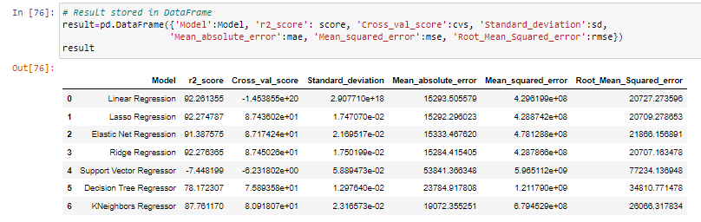
Result of ML Models
We saved result of ML Models in DataFrame.
We can see that Ridge and Lasso Regression algorithms are performing well, as compared to other algorithms. Now we will try Hyperparameter Tuning to find out the best parameters and try to increase their scores.

Slide 31
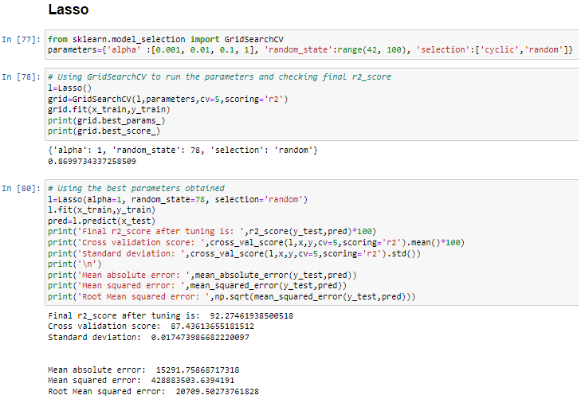
Hyperparameter Tuning

Slide 32
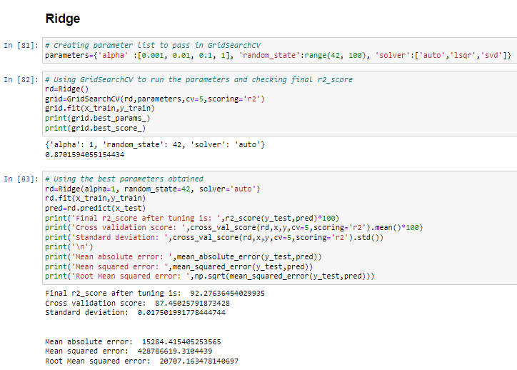
After Tuning the best algorithms, we can see that Lasso and Ridge Regression has been decreased slightly. Now, we will try Ensemble techniques like RandomForestRegressor, AdaBoostRegressor and GradientBoostingRegressor to boost up our scores.

Slide 33
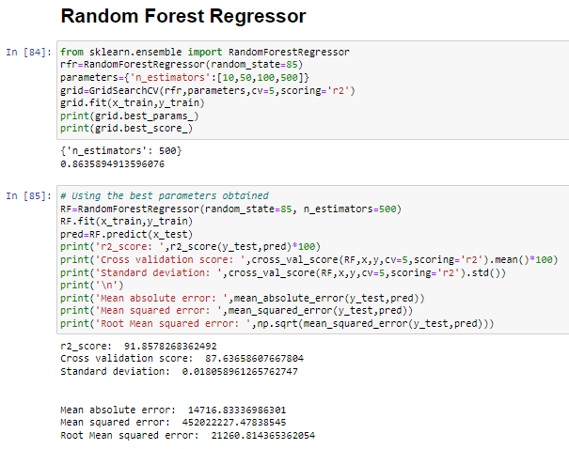

Slide 34
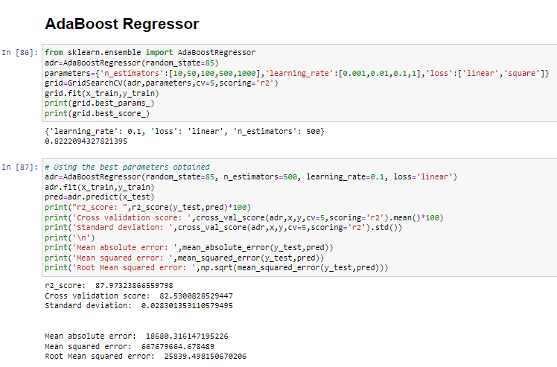

Slide 35
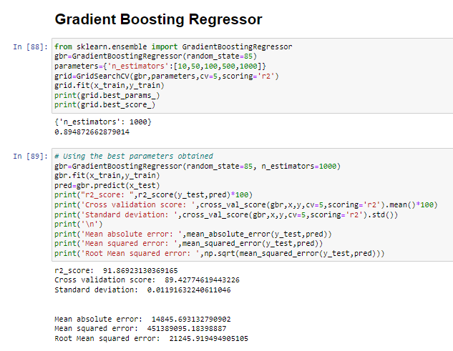

Slide 36
Key Metrics for success in solving problem under consideration
r2_score
Mean Absolute Error (MAE)
Mean Square Error (MSE)
Root Mean Square Error (RMSE)
Cross-validation
Hyperparameter Tuning using GridSearchCV
After applying Ensemble Techniques, we can see that GradientBoostingRegressor is the best performing algorithm among all other algorithms as it is giving a r2_score of 91.86 and cross validation score of 89.42. It has also the less amount of error values obtained. Lesser the RMSE score, the better the model.

Slide 37
Conclusion
After getting an insight of this dataset, we were able to understand that the Housing prices are done on basis of different features.
First, we loaded the train dataset and did the EDA process and other pre-processing techniques like skewness check and removal, handling the outliers present, filling the missing data, visualizing the distribution of data, etc.
Then we did the model training, building the model and finding out the best model on the basis of different metrices scores we got like Mean Absolute Error, Mean squared Error, Root Mean Squared Error, etc.
We got Lasso Regressor as the best algorithm among all as it gave more r2_score and cross_val_score. Then for finding out the best parameter and improving the scores, we performed Hyperparameter Tuning.
As the scores were not increased, we also tried using Ensemble Techniques like RandomForestRegressor, AdaBoostRegressor and GradientBoostingRegressor algorithms for boosting up our scores. Finally, we concluded that GradientBoostingRegressor was the best performing algorithm, although there were more errors in it and it had less RMSE compared to other algorithms. It gave an r2_score of 91.86 and cross_val_score of 89.42 which is the highest scores among all.

Slide 38
We saved the model in a pickle with a filename in order to use whenever we require.
We predicted the values obtained and saved it separately in a csv file.
Then we used the test dataset and performed all the pre-processing pipeline methods to it.
After treating skewness, we loaded the saved model that we obtained and did the predictions over the test data and then saving the predictions separately in a csv file.
From this project, we learnt that how to handle train and test data separately and how to predict the values from them. This will be useful while we are working in a real-time case study as we can get any new data from the client we work on and we can proceed our analysis by loading the best model we obtained and start working on the analysis of the new data we have.
The final result will be the predictions we get from the new data and saving it separately.
Overall, we can say that this dataset is good for predicting the Housing prices using regression analysis and GradientBoostingRegressor is the best working algorithm model we obtained.
We can improve the data by adding more features that are positively correlated with the target variable, having less outliers, normally distributed values, etc.

Slide 39


